Slide 1
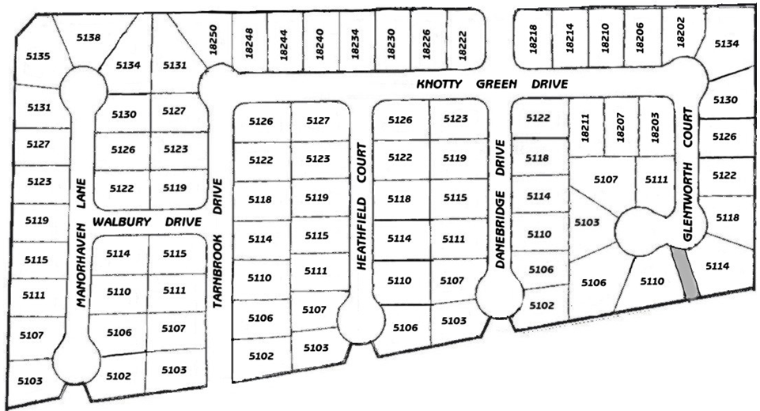
DEERFIELD VILLAGE SECURITY COMMITTEE SECTION 0NE
This section has 9 blocks
B1
B4
B5
B9
Legend
Block Number
B1
Block Captain
B8
Section Leader
B7
B3
B6
B2

Slide 2
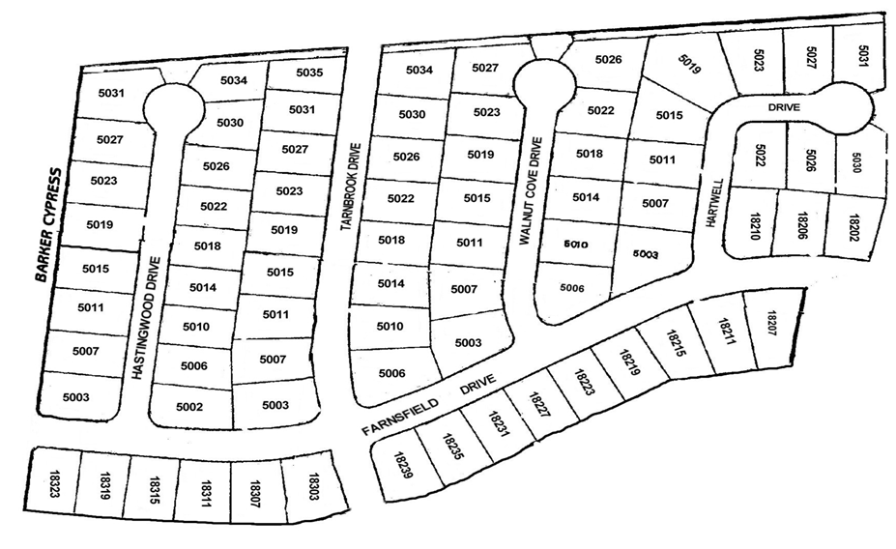
DEERFIELD VILLAGE SECURITY COMMITTEE SECTION TWO
This section has 6 blocks
B3
B1
B4
Legend
Block Number
B1
B5
Block Captain
Section Leader
B2
B6

Slide 3
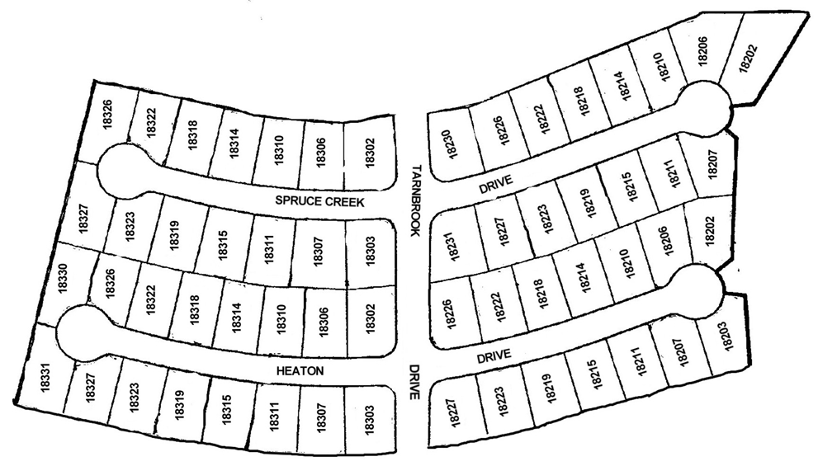
DEERFIELD VILLAGE SECURITY COMMITTEE SECTION THREE
This section has 4 blocks
B2
B1
Legend
Block Number
B1
Block Captain
Section Leader
B4
B3

Slide 4
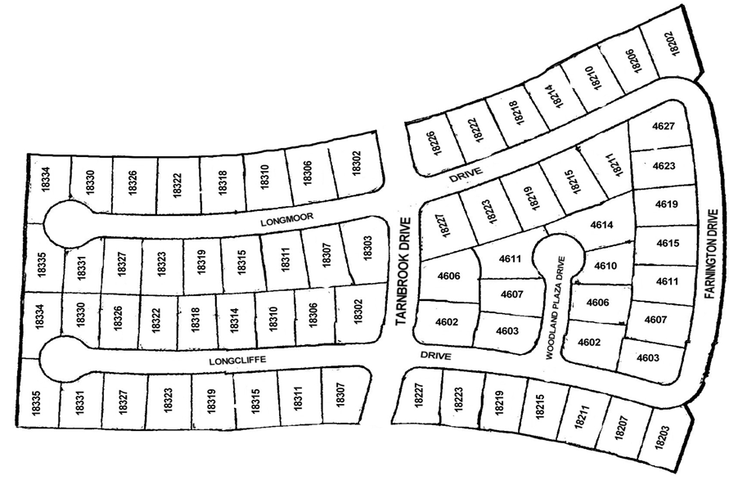
DEERFIELD VILLAGE SECURITY COMMITTEE SECTION FOUR
This section has 6 blocks
B3
Legend
Block Number
B1
B1
Block Captain
B5
Section Leader
B4
B2
B6

Slide 5
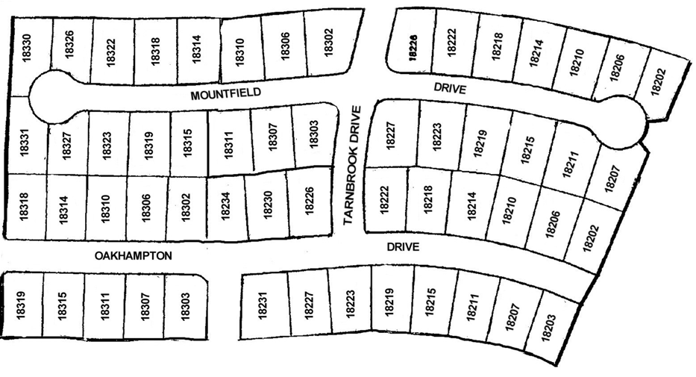
DEERFIELD VILLAGE SECURITY COMMITTEE SECTION FIVE
This section has 4 blocks
B3
B4
Legend
Block Number
B1
Block Captain
Section Leader
B1
B2

Slide 6
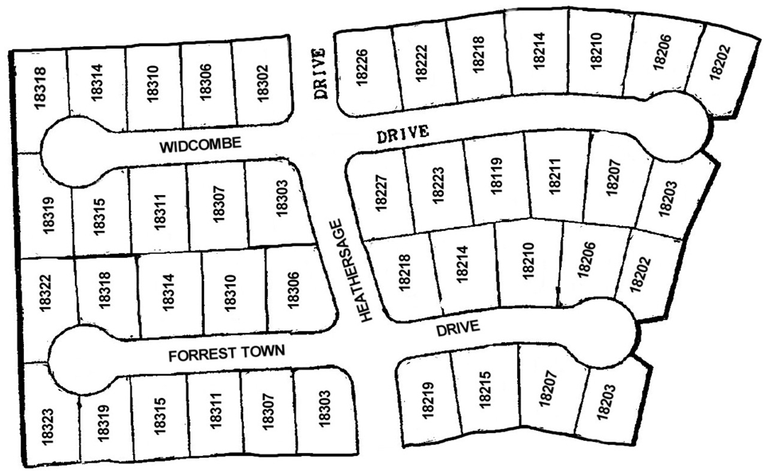
DEERFIELD VILLAGE SECURITY COMMITTEE SECTION SIX
This section has 4 blocks
B2
B1
Legend
Block Number
B1
Block Captain
Section Leader
B4
B3

Slide 7
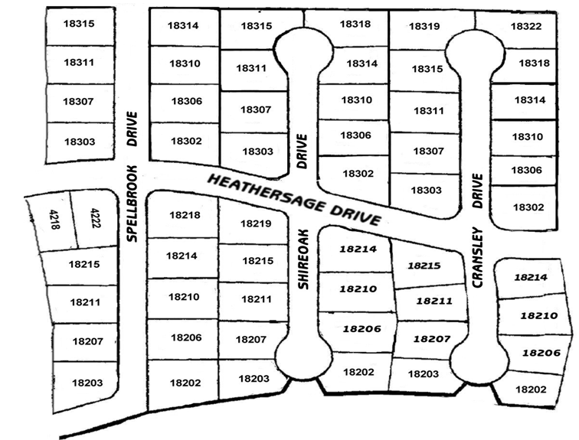
DEERFIELD VILLAGE SECURITY COMMITTEE SECTION SEVEN
This section has 6 blocks
B6
B5
B4
Legend
Block Number
B1
Block Captain
Section Leader
B1
B2
B3

Slide 8
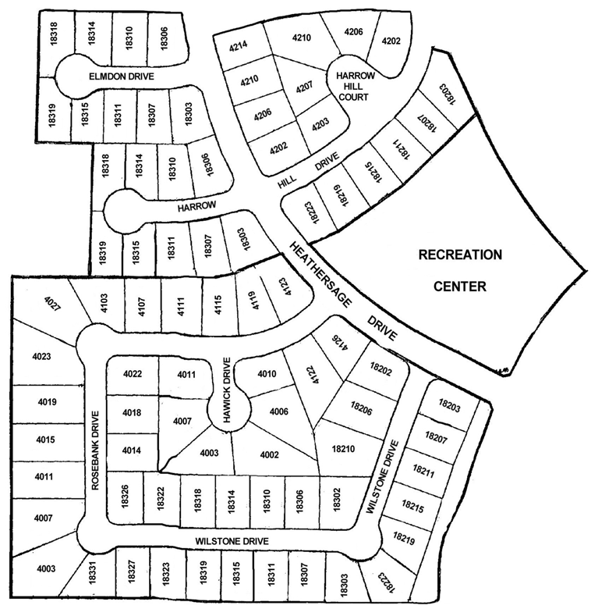
DEERFIELD VILLAGE SECURITY COMMITTEE SECTION EIGHT
This section has 9 blocks
B9
B8
B7
B6
Legend
Block Number
B1
Block Captain
B4
Section Leader
B3
B5
B2
B1

Slide 9
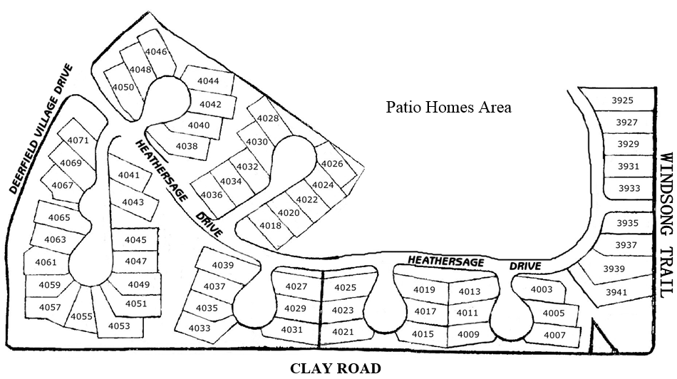
DEERFIELD VILLAGE SECURITY COMMITTEE SECTION NINE
This section has 7 blocks
B2
Legend
B3
Block Number
B1
Block Captain
B7
Section Leader
B1
B4
B5
B6

Slide 10
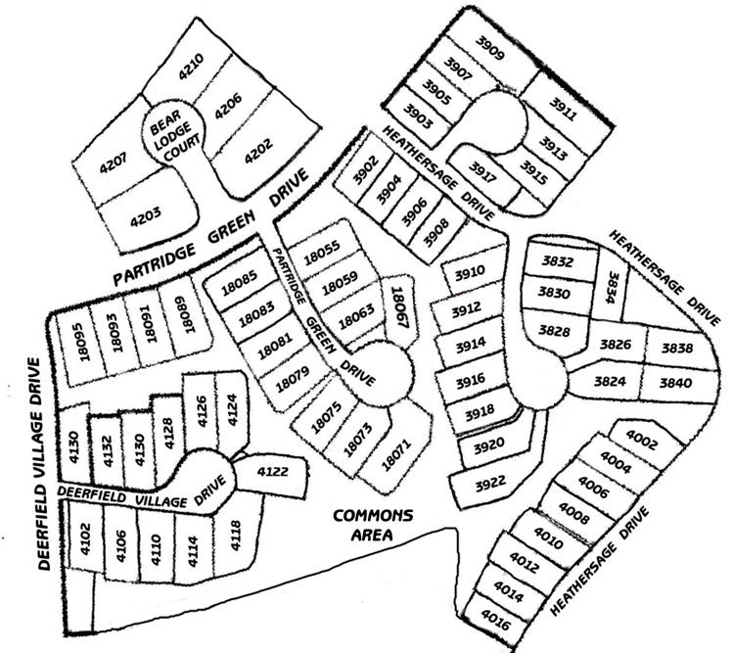
DEERFIELD VILLAGE SECURITY COMMITTEE SECTION TEN
This section has 7 blocks
B2
B1
Legend
Block Number
B1
B7
Block Captain
Section Leader
B5
B3
B4
B6

Slide 11
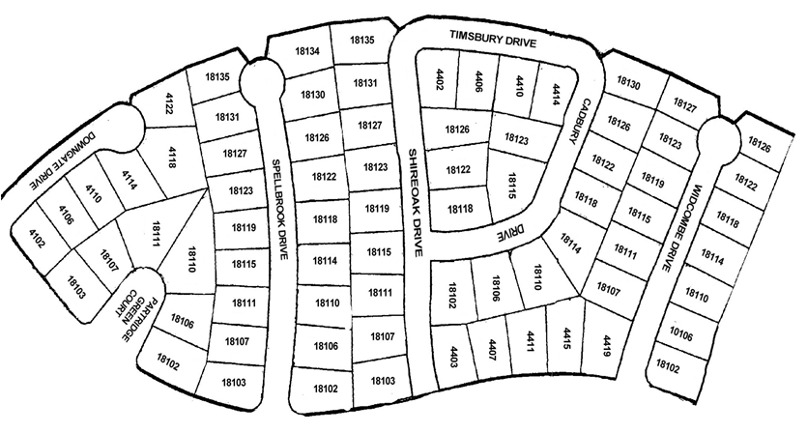
DEERFIELD VILLAGE SECURITY COMMITTEE SECTION ELEVEN
This section has 8 blocks
B5
B3
B2
B4
B7
Legend
Block Number
B1
Block Captain
B6
Section Leader
B1
Deerfield Village Drive
B8
Deerfield Village Drive

Slide 12
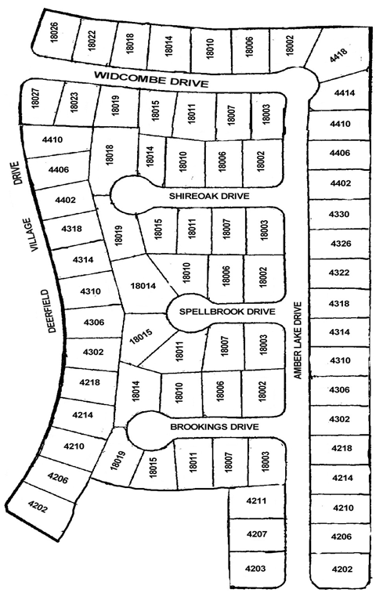
DEERFIELD VILLAGE SECURITY COMMITTEE SECTION TWELVE
This section has 7 blocks
B1
B2
B7
Legend
B5
B1
B6
Block Number
Block Captain
Section Leader
B4
B3

Slide 13
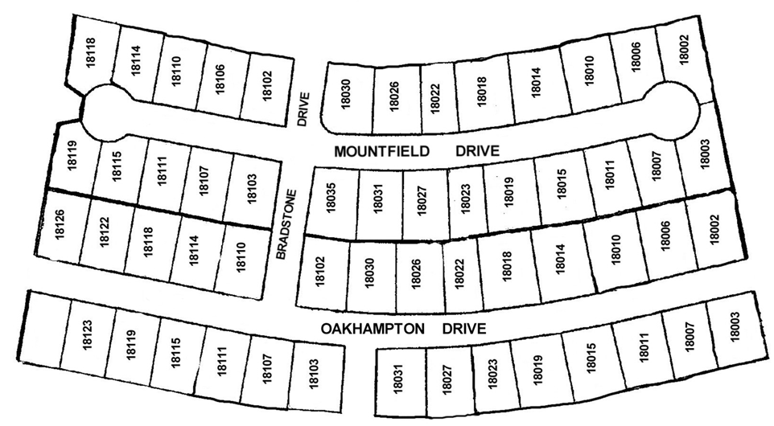
DEERFIELD VILLAGE SECURITY COMMITTEE SECTION THIRTEEN
This section has 4 blocks
B1
B2
Legend
Block Number
B1
Block Captain
Section Leader
B4
B3

Slide 14
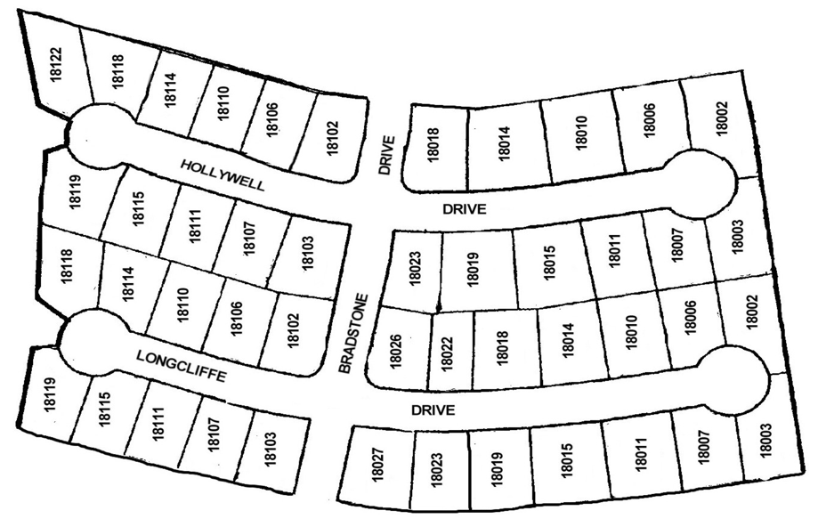
DEERFIELD VILLAGE SECURITY COMMITTEE SECTION FORTEEN
This section has 4 blocks
B1
B2
Legend
Block Number
B1
Block Captain
Section Leader
B4
B3

Slide 15
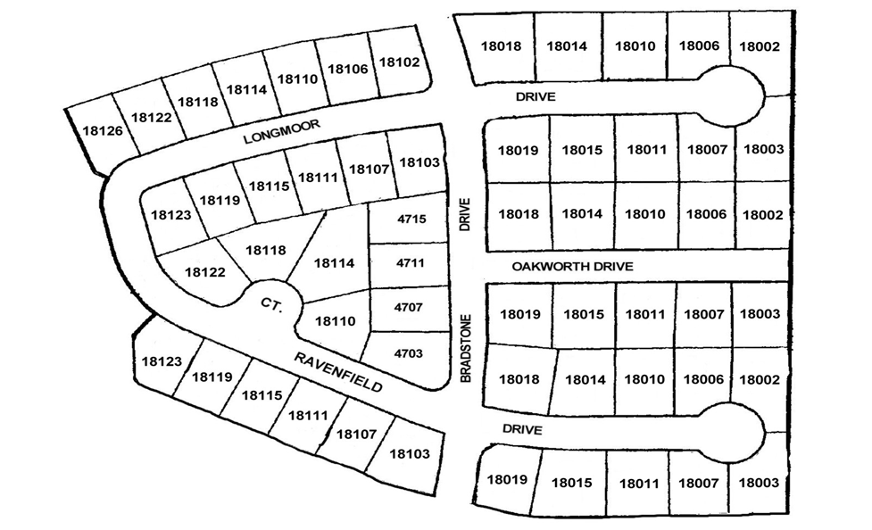
DEERFIELD VILLAGE SECURITY COMMITTEE SECTION FIFTEEN
This section has 6 blocks
B1
B2
Legend
Block Number
B1
B6
B5
Block Captain
Drainage Way - Greenbelt
Windsong Trail
Section Leader
B3
B4

Slide 16
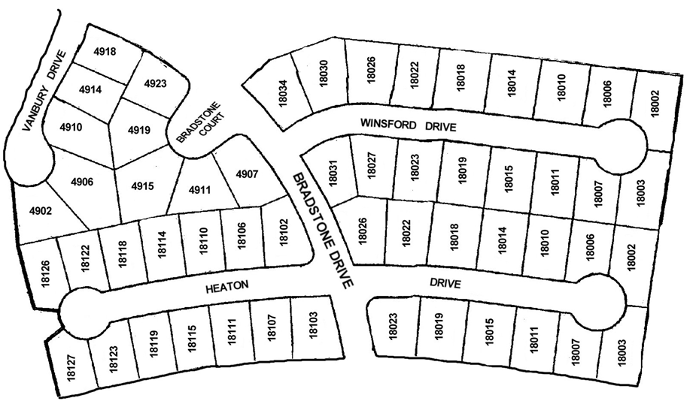
DEERFIELD VILLAGE SECURITY COMMITTEE SECTION SIXTEEN
This section has 5 blocks
B4
B3
Legend
B5
Block Number
B1
Block Captain
Section Leader
B2
B1

Slide 17
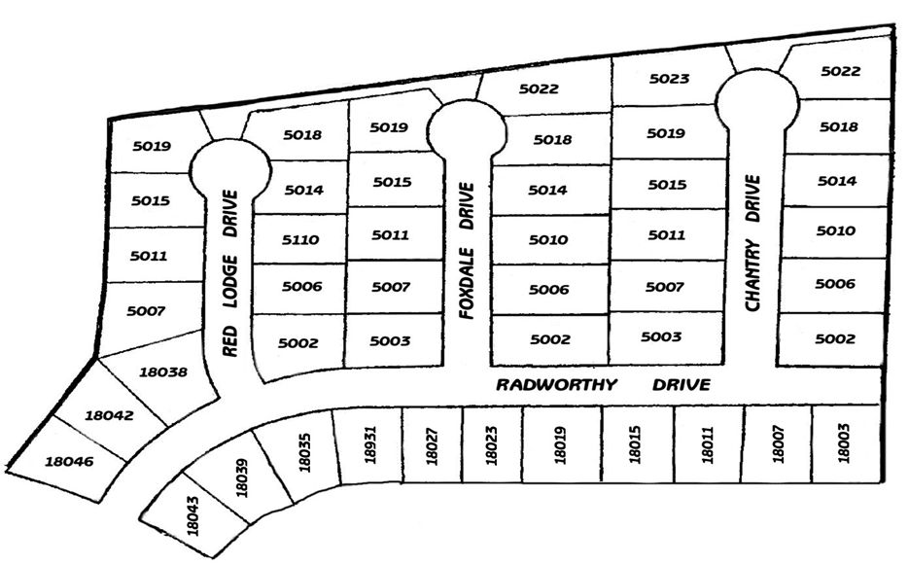
DEERFIELD VILLAGE SECURITY COMMITTEE SECTION SEVENTEEN
This section has 5 blocks
B5
B4
B3
Legend
Block Number
B1
Block Captain
Section Leader
B1
B2

Slide 18
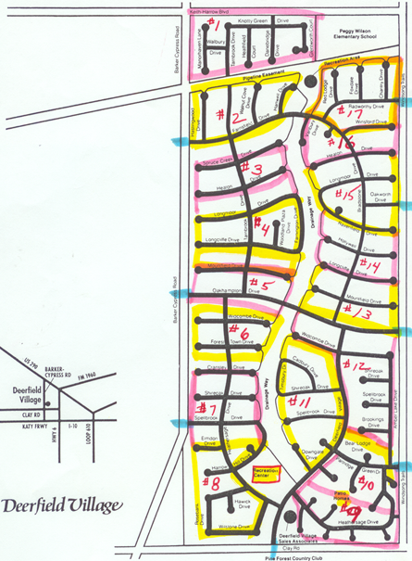
DEERFIELD VILLAGE SECURITY COMMITTEE SECTION MAP

